Slide 1
Elliptic Curve Cryptography: ECDH, ECDSA and Schnorr
분산네트워크연구실 32731 김희주

Slide 2
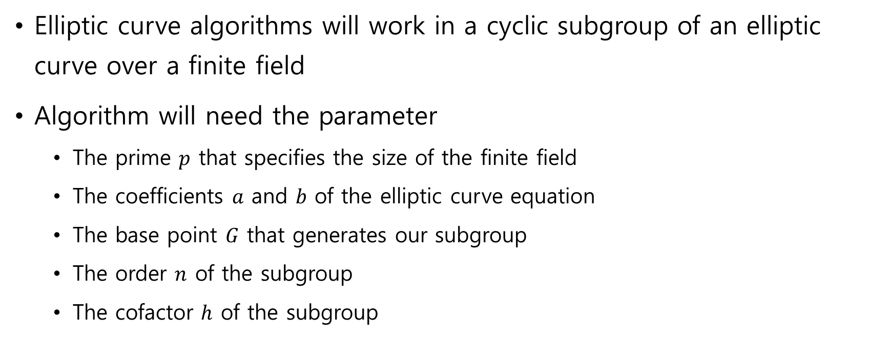
Domain Parameters
Elliptic curve algorithms will work in a cyclic subgroup of an elliptic curve over a finite field
Algorithm will need the parameter
The prime $p$ that specifies the size of the finite field
The coefficients $a$ and $b$ of the elliptic curve equation
The base point $G$ that generates our subgroup
The order $n$ of the subgroup
The cofactor $h$ of the subgroup
Domain parameters for our algorithms are the sextuple ($p, a, b, G, n, h$)

Slide 3
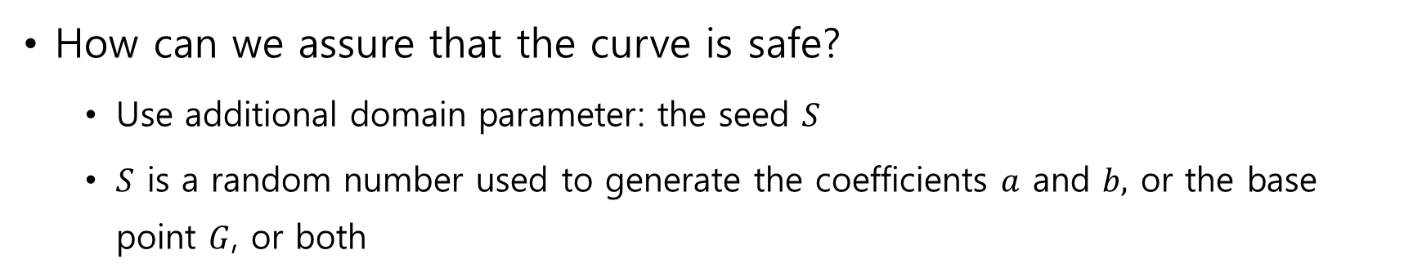
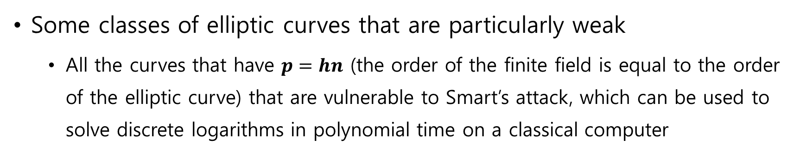
Random curves
Some classes of elliptic curves that are particularly weak
All the curves that have $p=hn$ (the order of the finite field is equal to the order of the elliptic curve) that are vulnerable to Smart’s attack, which can be used to solve discrete logarithms in polynomial time on a classical computer
How can we assure that the curve is safe?
Use additional domain parameter: the seed $S$
$S$ is a random number used to generate the coefficients $a$ and $b,$ or the base point $G$, or both

Slide 4
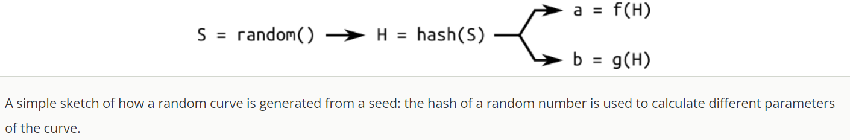
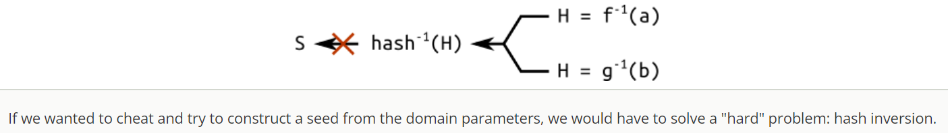

Random curves
$a, b, G$ are generated by computing the hash of the seed S
Hashes are “easy” to compute, but “hard” to reverse
A curve generated through a seed is said to be verifiably random
Known as “nothing up my sleeve”
The curve has not been specially crafted to expose vulnerabilities known to the author

Slide 5

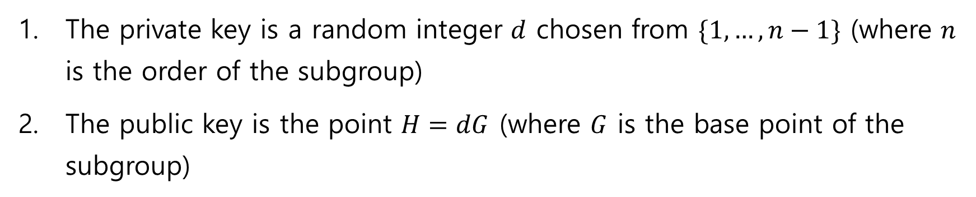
Elliptic Curve Cryptography
The private key is a random integer $d$ chosen from $\{1, …, n−1\}$ (where $n$ is the order of the subgroup)
The public key is the point $H=dG$ (where $G$ is the base point of the subgroup)
If we know $d$ and $G$(along with the other domain parameters), finding $H$ is “easy”
But if we know $H$ and $G$, finding the private key $d$ is “hard”
Discrete logarithm problem

Slide 6
Encryption with ECDH
ECDH is a variant of the Diffie-Hellman algorithm for elliptic curve
Key agreement protocol, more than an encryption algorithm
ECDH defines how keys should be generated and exchanged between parties
The problem it solves is the following: two parties want to exchange information securely, so that a third party (the Man In the Middle) may intercept them but may not decode them.

Slide 7
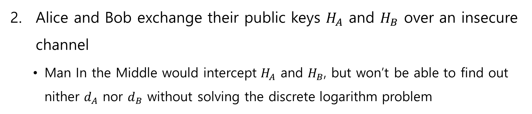
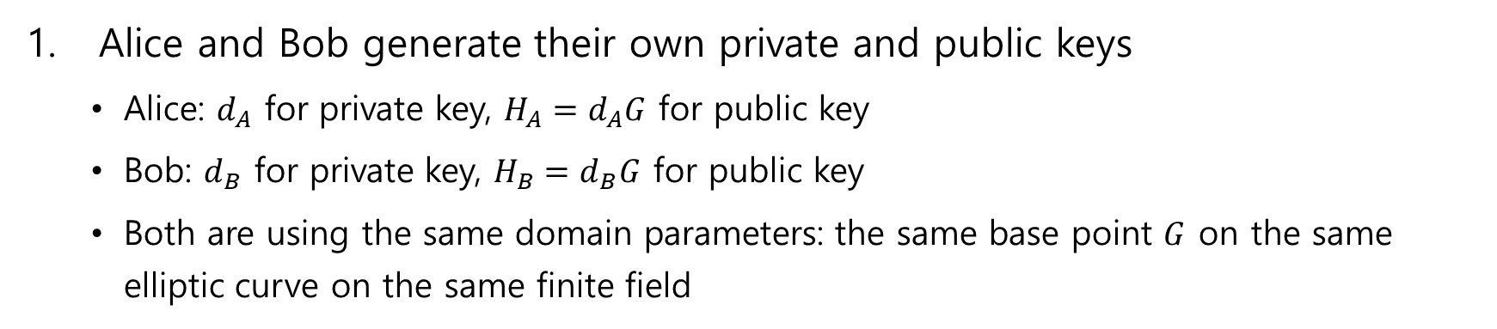
Encryption with ECDH
Alice and Bob generate their own private and public keys
Alice: $d_{A}$ for private key, $H_{A}=d_{A}G$ for public key
Bob: $d_{B}$ for private key, $H_{B}=d_{B}G$ for public key
Both are using the same domain parameters: the same base point $G$ on the same elliptic curve on the same finite field
Alice and Bob exchange their public keys $H_{A}$ and $H_{B}$ over an insecure channel
Man In the Middle would intercept $H_{A}$ and $H_{B}$, but won’t be able to find out nither $d_{A}$ nor $d_{B}$ without solving the discrete logarithm problem

Slide 8
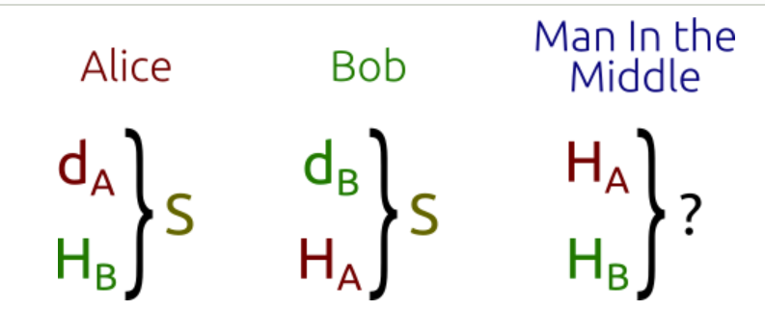

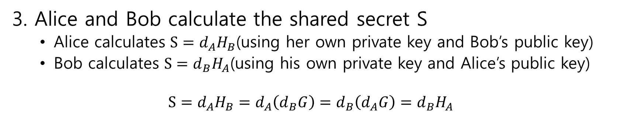
Encryption with ECDH
3. Alice and Bob calculate the shared secret S
Alice calculates $S=d_{A}H_{B}$(using her own private key and Bob’s public key)
Bob calculates $S=d_{B}H_{A}$(using his own private key and Alice’s public key)
$$S=d_{A}H_{B}=d_{A}\left(d_{B}G\right)=d_{B}\left(d_{A}G\right)=d_{B}H_{A}$$
This is known as the Diffie-Hellman problem, which can be started as follow
Given three points $P, aP$ and $bP$, what is the result of $abP$
Given three integers $k, k^{x}$ and $k^{y}$, what is the result of $k^{xy}$?
The Diffie-Hellman key exchange: Alice and Bob can “easily” calculate the shared secret, the Man in the Middle has to solve a “hard” problem

Slide 9
Encryption with ECDH
Diffie-Hellman problem for elliptic curves is assumed to be a “hard” problem
Solving the logarithm problem is a way of solving the Diffie-Hellman problem
Now Alice and Bob have obtained the shared secret, they can exchange data with symmetric encryption

Slide 10
Ephemeral ECDH
ECDHE
“E” in ECDHE stands for “Ephemeral(일시적인)” and refers to the fact that the keys exchanged are temporary
Used in TLS, where both the client and the server generate their public-private key pair on the fly
Keys are signed with the TLS certificate (for authentication) and exchanged between the parties

Slide 11
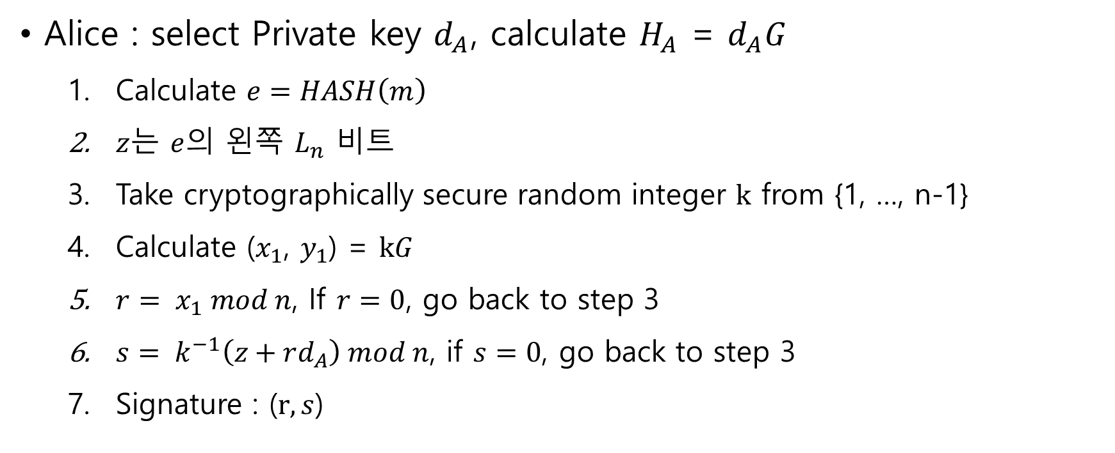
ECDSA
Alice : select Private key $d_{A}$, calculate $H_{A}$ = $d_{A}G$
Calculate $e=HASH\left(m\right)$
$z$는 $e$의 왼쪽 $L_{n}$ 비트
Take cryptographically secure random integer $k$ from {1, …, n-1}
Calculate ($x_{1}$, $y_{1}$) = $kG$
$r= x_{1} mod n$, If $r=0$, go back to step 3
$s= k^{−1}\left(z+rd_{A}\right) mod n$, if $s=0$, go back to step 3
Signature : ($r, s$)

Slide 12
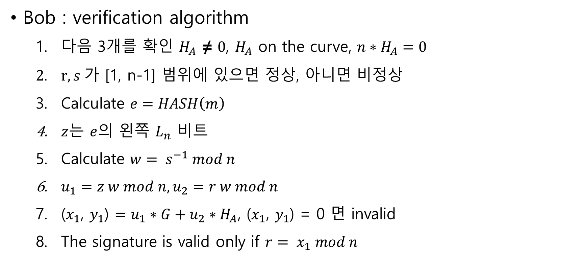
ECDSA
Bob : verification algorithm
다음 3개를 확인 $H_{A}$ ≠ $0$, $H_{A}$ on the curve, ${n∗H}_{A}=0$
$r, s 가$ [1, n-1] 범위에 있으면 정상, 아니면 비정상
Calculate $e=HASH\left(m\right)$
$z$는 $e$의 왼쪽 $L_{n}$ 비트
Calculate $w= s^{−1} mod n$
$u_{1}=z w mod n, u_{2}=r w mod n$
($x_{1}$, $y_{1}$) $=u_{1}∗G+u_{2}∗H_{A}$, ($x_{1}$, $y_{1}$) = 0 면 invalid
The signature is valid only if $r= x_{1} mod n$

Slide 13
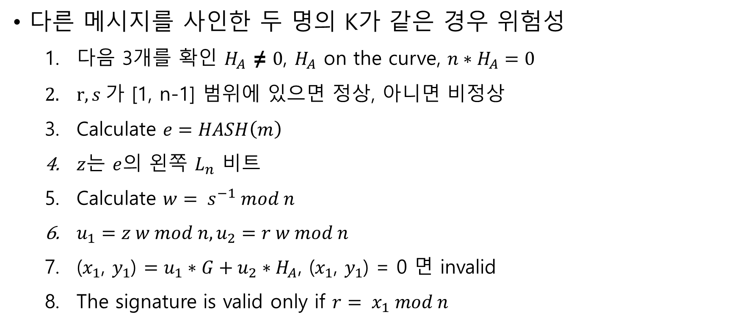
ECDSA
다른 메시지를 사인한 두 명의 K가 같은 경우 위험성
다음 3개를 확인 $H_{A}$ ≠ $0$, $H_{A}$ on the curve, ${n∗H}_{A}=0$
$r, s 가$ [1, n-1] 범위에 있으면 정상, 아니면 비정상
Calculate $e=HASH\left(m\right)$
$z$는 $e$의 왼쪽 $L_{n}$ 비트
Calculate $w= s^{−1} mod n$
$u_{1}=z w mod n, u_{2}=r w mod n$
($x_{1}$, $y_{1}$) $=u_{1}∗G+u_{2}∗H_{A}$, ($x_{1}$, $y_{1}$) = 0 면 invalid
The signature is valid only if $r= x_{1} mod n$

Slide 14
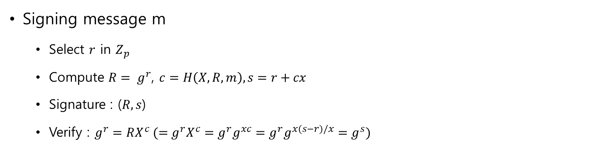
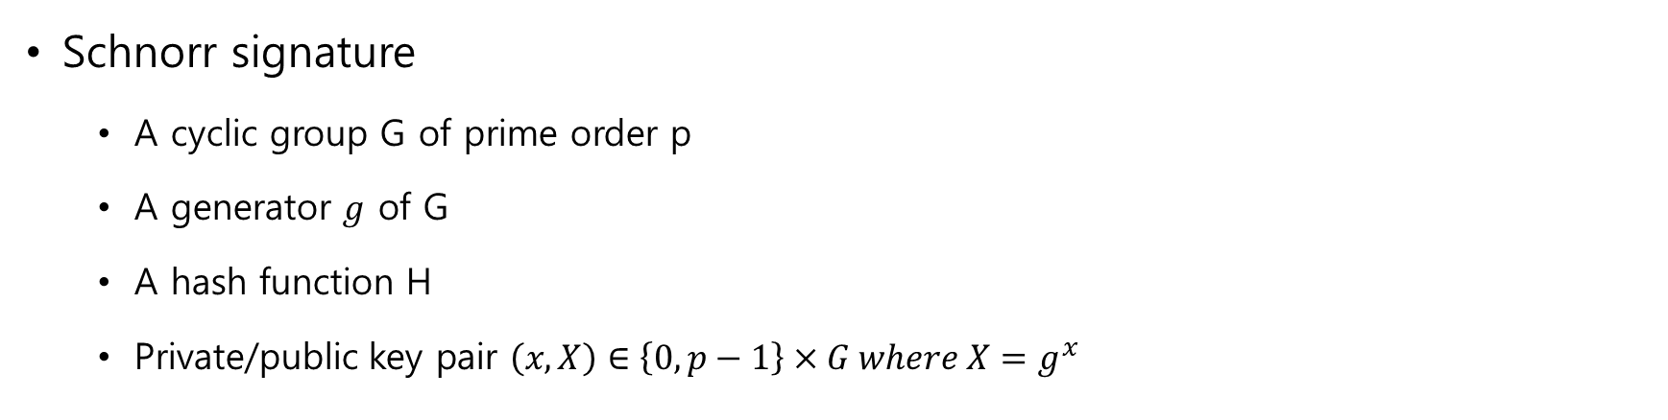
Schnorr signature
Schnorr signature
A cyclic group G of prime order p
A generator $g$ of G
A hash function H
Private/public key pair $\left(x, X\right)∈\left\{0, p−1\right\}×G where X=g^{x}$
Signing message m
Select $r$ in $Z_{p}$
Compute $R= g^{r}$, $c=H\left(X, R, m\right), s=r+cx$
Signature : ($R, s$)
Verify : $g^{r}=RX^{c} (=g^{r}X^{c}=g^{r}g^{xc}=g^{r}g^{x(s−r)/x}=g^{s})$

Slide 15

Schnorr signature
Naive way Multi-sign : n signer with a message m
$L=\left\{X_{1}=g^{x_{1}}, …,X_{n}=g^{x_{n}}\right\}$ set of public key
$R= \prod_{i=1}^{n}{R_{i}} :R_{i}$ = $g^{r_{i}}$
$c=H\left(\tilde{X}, R, m\right): \tilde{X}$ = $\prod_{i=1}^{n}{X_{i}}$
$s=\prod_{i=1}^{n}{s_{i}} mod p$ : $s_{i}=r_{i}+cx_{i}$
Signature : ($R, s$)
Verify : $g^{s}=R{\tilde{X}}^{c}$
Rogue-key attack에 취약

Slide 16
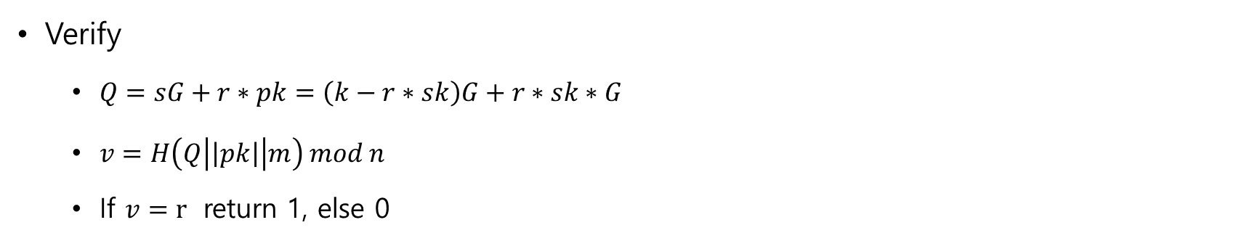
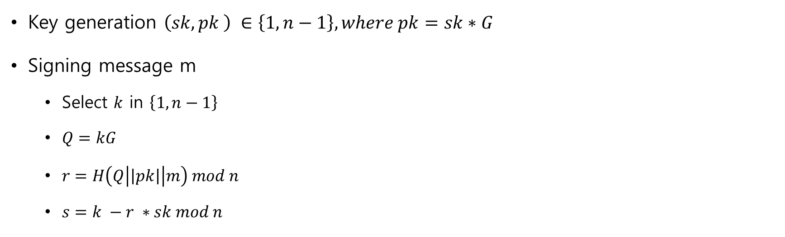
EC-Schnorr signature
Key generation $\left(sk, pk \right) ∈\left\{1, n−1\right\}, where pk=sk∗G$
Signing message m
Select $k$ in $\left\{1, n−1\right\}$
$Q=kG$
$r=H\left(Q\left|\left|pk\right|\right|m\right) mod n$
$s=k −r ∗sk mod n$
Verify
$Q=sG+r∗pk=\left(k−r∗sk\right)G+r∗sk∗G$
$v=H\left(Q\left|\left|pk\right|\right|m\right) mod n$
If $v=r$ return 1, else 0

Slide 17

EC-Schnorr multi-signature
Key generation $\left(sk, pk \right) ∈\left\{1, n−1\right\}, where pk=sk∗G$
Signing message m
Select $k_{i}$ in $\left\{1, p−1\right\}$
$Q=k_{i}G$
$Pk= \prod_{i=1}^{n}{{pk}_{i}}$
$Q= \prod_{i=1}^{n}{Q_{i}}$
$r=H\left(Q\left|\left|pk\right|\right|m\right) mod p$
$s_{i}=k_{i}−r ∗sk_{i} mod p$
$S= \sum_{i=1}^{n}{S_{i}}$
Signature: $\left(r, S\right)$

Slide 18

EC-Schnorr multi-signature
Verify
$Q=SG+r∗Pk$
$v=H\left(Q\left|\left|Pk\right|\right|m\right) mod p$
If $v=r$ return 1, else 0

